Slide 1

Android Debug Bridge (adb)
Operating system Security

Slide 2
Android Debug Bridge (adb)
adb is included in the Android SDK Platform Tools package.
Android SDK Platform-Tools is a component for the Android SDK.
It includes tools that interface with the Android platform, primarily adb and fastboot.
fastboot is needed if you want to unlock your device bootloader and flash it with a new system image.
Go to the download option by scrolling down to install the Android SDK Platform Tools for Windows, Linux or Mac.

Slide 3
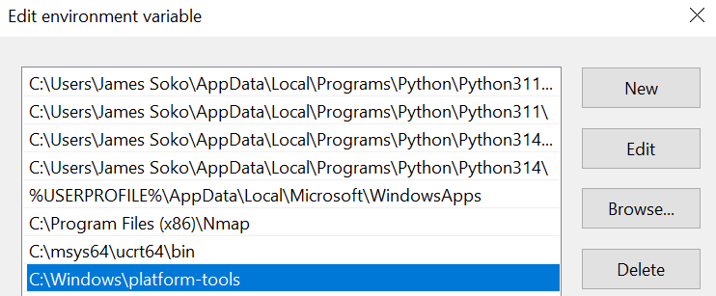
Adb Windows Set Up
Extract the zipped Folder, move the extracted Folder to Local Disk (C) inside the Windows Folder e.g., C:\Windows
Now, add the path C:\Windows\platform-tools to the Environmental Variables
Restart your computer for the changes to be effective.

Slide 4
Android Emulator
MEmu

Slide 5


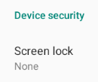
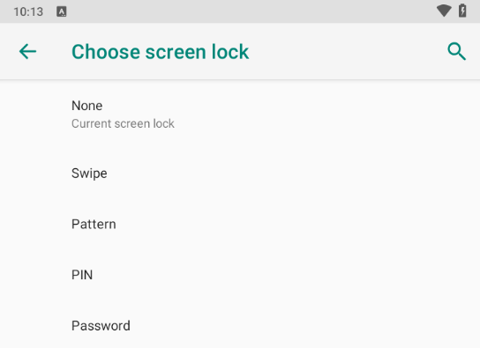

Adb Android Lock screen Bypass
Let’s assume you have an Android Emulator already set up (i.e., MEmu).
Set up a PIN
Now, let’s assume you’ve forgotten your PIN. Open CMD and run the command adb devices
Run the command adb shell to access the active/connected device.

Slide 6
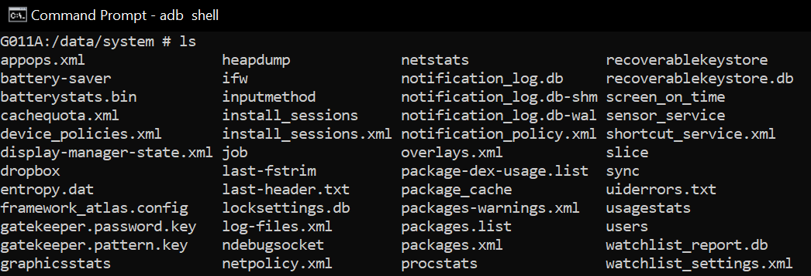
Adb Android Lock screen Bypass (Continues…)
The lock screen files are located in /data/system so we would like to target those but which one exactly? Run cd data/system
hh

Slide 7

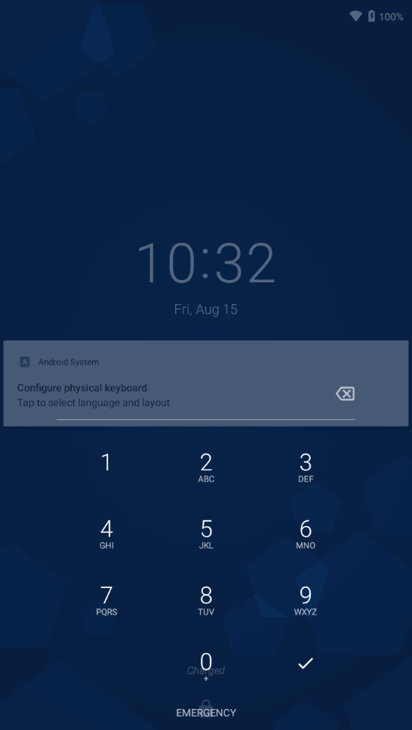
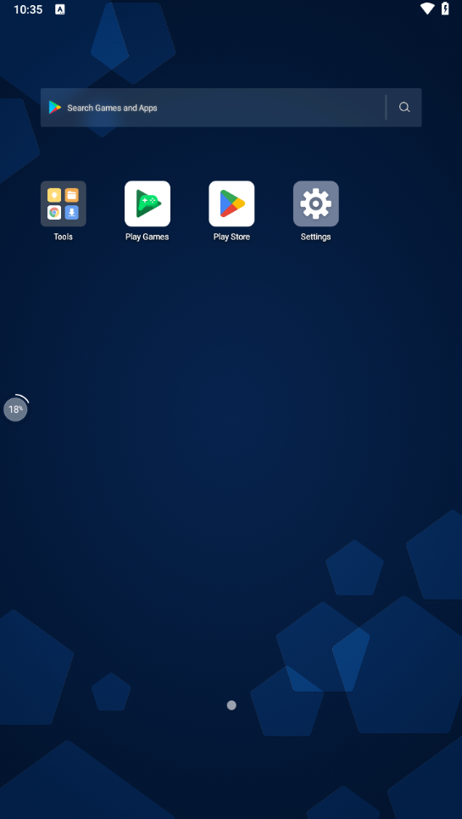
Adb Android Lock screen Bypass (Continues…)
Will remove locksettings.db with the command rm locksettings.db
Now, restart your device for the changes to be effective.

Slide 8
Android Device
Actual Phone

Slide 9
Adb Android Lock screen Bypass (Continues…)
Enable USB Debugging on your Android device. Go to: Settings → About phone → Tap Build number 7 times to unlock Developer Options.
Go to: Settings → Developer options → Enable USB Debugging
Now run the command adb devices -l

Slide 10
*#85004173807*854*#

